Slide 1

[Aggregate Anseong Plant] Electric Shock RCA Report
- Table of Contents -
Ⅰ. RCA Attendees
Ⅱ. Accident Overview
Ⅲ. Root Cause Analysis (RCA)
Ⅳ. Recurrence Prevention Measures
2024.10.02
Anseong Plant

Slide 2
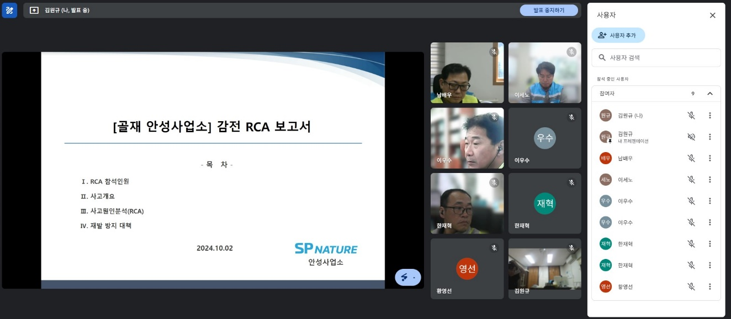
Ⅰ. RCA Attendees
RCA (Root Cause Analysis)
No | Name | Company / Department | Title
1 | Ko Chang-soo | ㈜SP Nature / Environment Safety | CSO
2 | Yoo Min-cheol | ㈜SP Nature / Construction Materials Safety Part | Safety Part
3 | Kim Ho-gyeom | SP Nature Co., Ltd. / Construction Material Safety Part | Safety Part
4 | Kim Jun-hee | SP Nature Co., Ltd. / Anseong Plant | Production Team Leader
5 | Kim Won-gyu | SP Nature Co., Ltd. / Anseong Plant | Safety Officer
6 | Lee Se-no | SP Nature Co., Ltd. / Yesan Plant | Plant Manager
7 | Lee Woo-soo | SP Nature Co., Ltd. / Yesan Plant | Safety Officer
8 | Han Jae-hyuk | SP Nature Co., Ltd. / Yesan Branch | Production Team Leader
No | Name | Company / Affiliation | Title
9 | Nam Bae-woo | Hongmyung Industry Co., Ltd. | Plant Manager
10 | Hwang Young-sun | Hongmyung Industry Co., Ltd. | Safety Officer
11
12
13
14
15
16
Meeting Photos

Slide 3
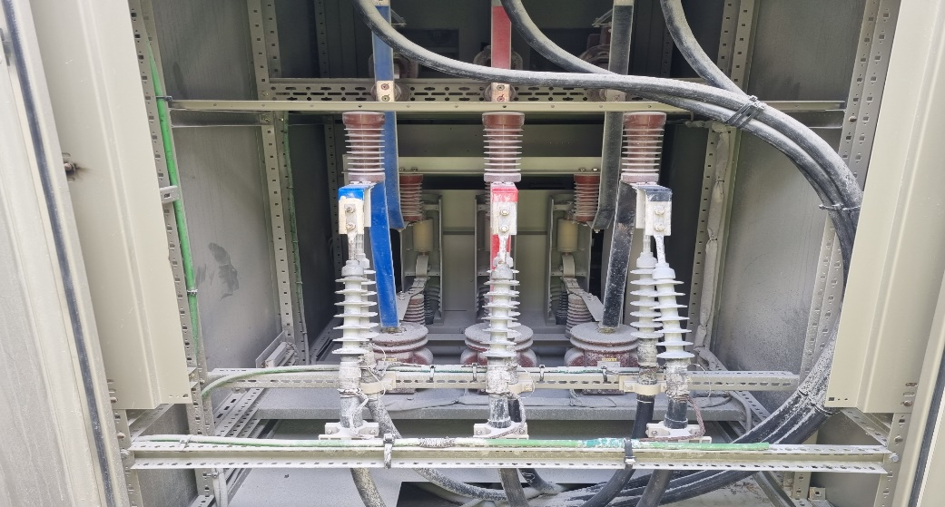
Ⅱ. Accident Overview
RCA (Root Cause Analysis)
Aggregate Anseong Plant Electric Shock Accident
Accident Occurrence Status
1. Date / Location | 2024.09.27 (Fri), around 10:45 AM / Panel Room
2. Injured / Affiliation | Euntaek Kim, Manager / Anseong Plant, Production Team | 3. Gender / Age | Male / Age 30
4. Type of Accident | Electrocution | 5. Extent of Injury | Burn (Undergoing hospital treatment)
□ Accident Details ∙ On September 27, 2024 (Fri), around 10:45 AM, Anseong Plant Production Team Manager, Kim Eun-taek, was checking the status of corrective actions for deficiencies identified during the equipment inspection conducted in August (VCB panel internal dust accumulation) at the on-site substation. He opened the panel to remove the dust inside and was blowing with his mouth, resulting in an electric shock accident. ※ Undergoing burn treatment at Osong Bestian Hospital, then admitted to Yeongdeungpo Hangang Sacred Heart Hospital □ Accident Causes ∙ Failure to comply with substation entry procedures (insufficient control by the electrical safety manager) ∙ Failure to implement LOTO (power not shut off) / Joint Key management (Production Team) ∙ Safety permit work order not prepared / 2-person inspection not implemented ∙ Failure to wear insulated protective equipment □ Recurrence Prevention Measures ∙ Strengthen substation entry procedures (One key management / Entry log creation) ∙ Implement LOTO (power shut off, control panel: ASS Controller) ∙ Prepare safety work permit / Implement 2-person inspection ∙ Wear insulated protective equipment
Accident Scene Photos

